Slide 1
Percentages
Grade 11

Slide 2


Follow these instructions……………….
Write the note in slide 3 & do the review exercise in slide 6
Write the note in slides 7,8 & do the exercise in slide 10
Write the topic, definition in slide 11.Then study the examples and do the
exercise 9.2
Write the note in slides 16,23 & do the exercise 9.1 & Miscellaneous Exercise.

Slide 3
What is a percentage….
A percentage is a fraction with denominator 100
3/100
28/100
234/100
3%
28%
234%

Slide 4
How to convert fractions & decimals into percentages….
Eg.. 3/5 3/5 × 100 % = 60%
5/8
5/8 × 100 %
= 62.5%
0.32
0.32 × 100 %
= 32%
4.12
4.12 × 100 %
= 412%

Slide 5

Questions related with percentages
Answers : a. 800 ×
b. 1000 ×
c. 1200 ×
d. 2500 ×
12/100 = 96 rupees 8/100 = 80 m
2.5/100 = 30 g
25/100 = 625 ml

Slide 6
Eg;
A shopkeeper buys a wristwatch for Rs 500 and sells it for Rs 600. Calculate the profit as a percentage (of the cost price).
Answer :
profit = Rs (600 – 500 = Rs.100 profit percentage= 100/500 × 100 = 20%
Review questions
If 30 of the 50 students in a class are girls, find the number of girls in the class as a percentage of the total number of students.
15% of the workers in an establishment are men. If the total number of workers in the establishment is 800, how many male workers are there?
After spending 65% of the money he had in hand, if a person had a balance of Rs. 1400, what is the total amount of money he initially had?

Slide 7
Interset
When a loan has been taken from an individual or an institution, the extra amount that has to be paid when settling the loan after a period of time is called the interest
Similarly, when money has been deposited in a bank or some other financial institution for a period of time, the extra amount that is received at the end of the period is also called the interest
Usually, the interest that has to be paid for a year is a percentage of the loan amount (or deposit amount). This percentage is called the annual interest rate. The interest rate can also be given monthly or semi-annual

Slide 8

We can calculate the interest
As a simple interest
As a compound interest On the reducing balance

Slide 9
Simple Interest
When calculating the interest for a specific period, if only the initial amount (principal value) is taken into consideration, then such interest is called simple interest
In here there are 4 types of questions
Find the total amount
Find the annual simple interest rate Find the time duratiom
Find the principal value.

Slide 10
Review exercises
Find the total amount that Senal has to pay to settle a loan in three months, if he borrowed Rs.8 000 at a monthly simple interest rate of 2%
How long will it take for a person who gave a loan of Rs10 000 at an annual simple interest rate of 12%, to receive an interest of Rs.3 600
If the simple interest that had to be paid for two years, on a loan of Rs.7 500 was Rs.1 200, find the annual simple interest rate that was charged.
If the total amount that had to be paid after 4 months to settle a loan borrowed at a monthly simple interest rate of 1.5% was Rs.5 300, find the loan amount

Slide 11
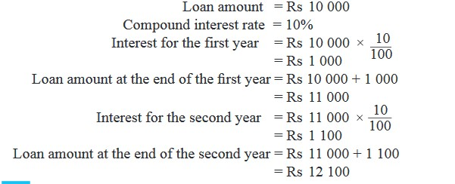
Compound Interest
Compound interest is the addition of interest to the principal sum of a loan or deposit, or in other words, interest on interest.
Eg 1
If a person takes a loan of Rs 10 000 at a compound interest rate of 10% per year, calculate the total amount required to repay the entire loan in two years.
First method


Slide 12
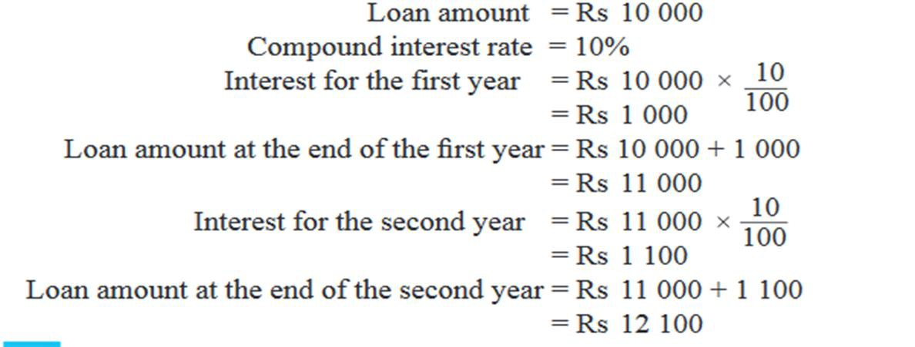
study the earlier example………………
10000 ×110/100
= 11000
11000 ×110/100
=12100
Second method
Loan amount at the end of second year = 10000 × 110/100 × 110/100
= Rs12100

Slide 13
Eg 2
A person who has loaned a certain amount at 8% interest compounded yearly, receives Rs 432 as compound interest at the end of two years. Find the amount that he loaned
In hrere it is easy to use the second method…………..
Take the amount that he loaned as ‘y’

Y × 108/100 × 8 /100
y
= 432
= 432 × 100 × 100
108 × 8
= Rs.5000
y
Do the exercise 9.2…………………..

Slide 14
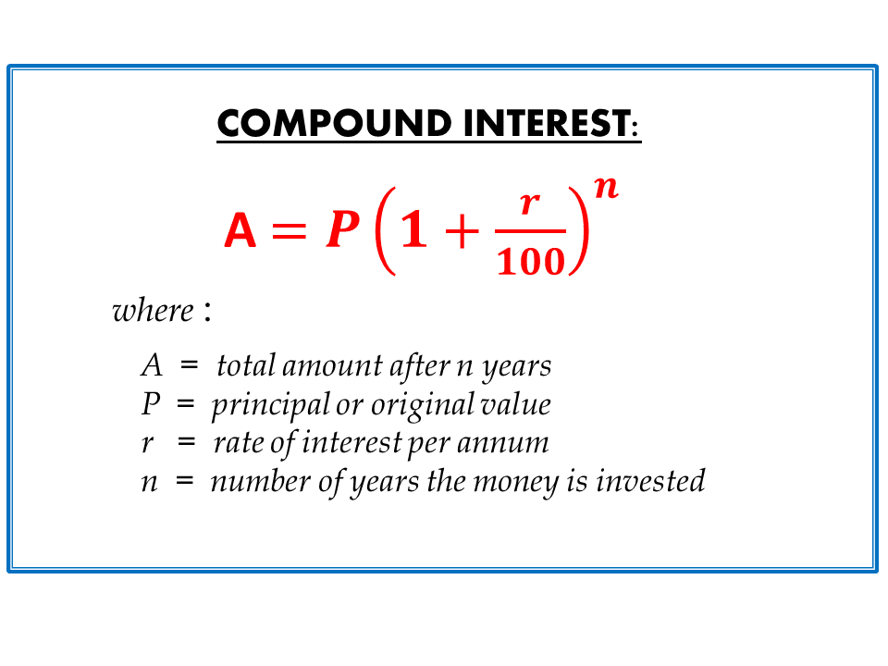
For further studies……
Third method

Slide 15
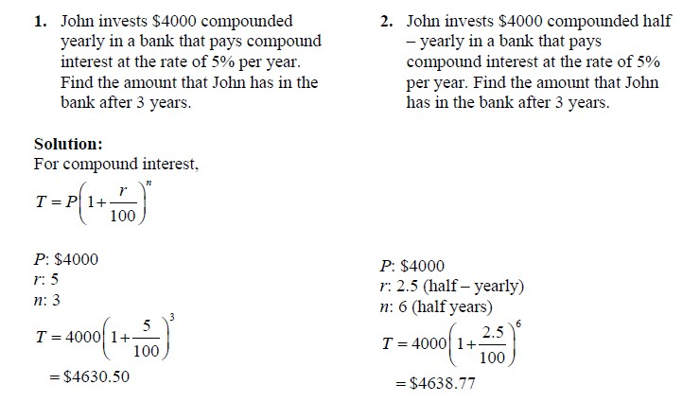
Example of third method :

Slide 16
Calculating interest on reducing balance
The goods we need can be classified as essential goods and luxury goods. According to certain criteria of living, luxury goods may also be considered as essential goods in some instances. Eg.Refrigarators, washing machines, televisions…………
Some business establishments which promote the sale of these kind of items sometimes advertise to pay a part of the cost of theses items initially(down payment) and to pay the balance in installments. But for the balance they will also charge an interest in the decreasing balance of payment.
Therefore this method of calculating the interest is called, computing the interest on the reducing balance.
Once the total interest to be paid is calculated, the monthly installments are determined, such that every installment is of the same value

Slide 17

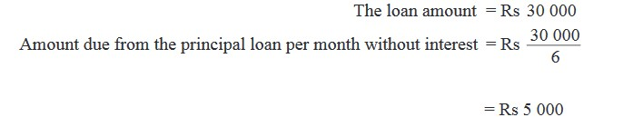
Study this example…………

Slide 18
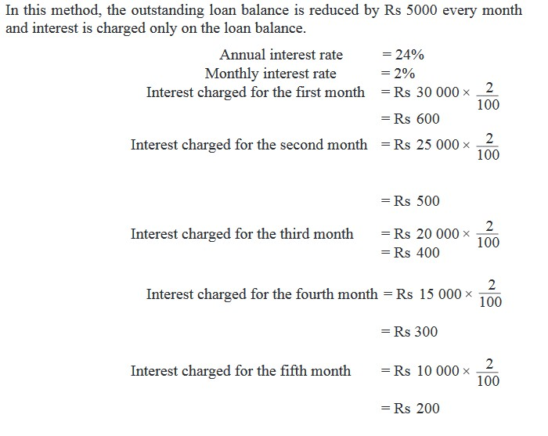
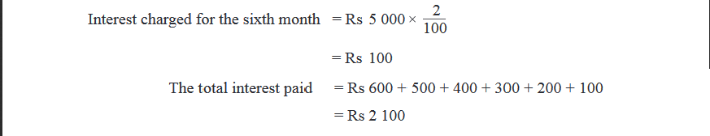
Interest is calculated according to reducing balance

Slide 19
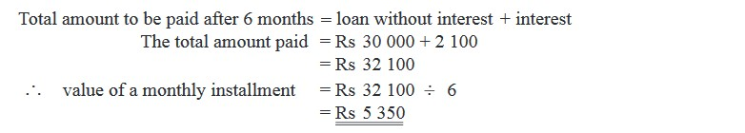


Slide 20
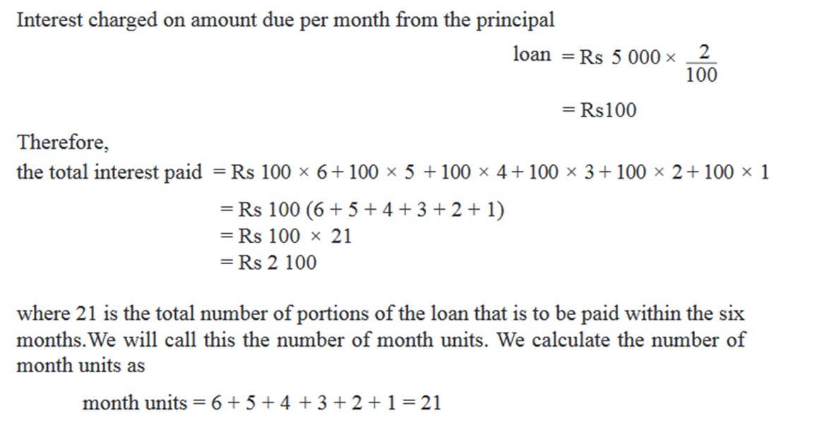

Slide 21
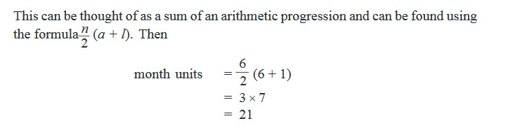

Month units =
n (n+1)/ 2
n =number of instalments

Slide 22
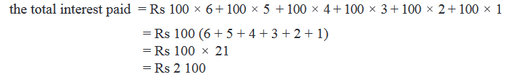
Interest per month
Monthly units
Total Interest = Interest per month × month units

Slide 23
To remember:
Monthly units = n (n+1)/ 2
n =number of instalments
Total Interest = Interest per month × monthly units

Slide 24
Calculating monthly installment
Example 1
The cost of a washing machine is Rs72000. It can also be bought by paying Rs.20000 as a down payment and the balance can be paid in 13 equal monthly installments. The establishments charges an interest of 9% on the decreasing balance of payment. Find the amount to be paid in an installment
Answer:
The remaining balance to paid

= (Rs 72000- 20000)
Rs 52000
The loan share to be paid in one month = Rs 52000 ÷13
 = 4000

Slide 25
   | Monthly units | = n (n+1)/ 2 = (13 × 14)/ 2 = 91 | n=13
  | Total interest | = interest per month × monthly units = (4000 × 9) × 91
      | The total amount to paid The monthly instalment | 100 = Rs 32760 = 52000 + 32760 = Rs 84760 = Rs 84760 ÷ 13 = Rs 6520

Slide 26
Calculating the interest percentage
A colour television set worth Rs 32,400 is available for a down payment of Rs10,000 and 14 equal monthly instalments of Rs 1900. If the interest on the loan was calculated on the reducing loan balance, calculate the interest rate.
Answer :
The balance money

= Rs.(32400 – 10000)
= Rs 22400
The monthly payment on the loan =Rs.22400 ÷ 14

The monthly units


= Rs 1600
= n (n+1)/ 2
= 14 × 15 / 2
= 105
n=14

Slide 27
The total money paid in 14 months
at Rs 1900 monthly
The interest charged

= Rs 1900 × 14
= Rs 26600
= Rs 26600 – Rs 22400
= Rs 4200
Total interest
= interest per month × monthly units
 | 4200 | = | y | × 105
 | 4200 | = | y
 | 105
   | Rs 40 | = | y

Slide 28
The rate of Interest ( It means find the interest for Rs100 for 1 year)
   | interest per month Rs 1600 Rs 100 |  | Interest per month Rs 40 ? ( assume it is ‘r’)
  | 1600 × r | = | 40 × 100 × 12 (to find annual rate)
 | r | = | 40 × 100 × 12
 |  |  | 1600
 | r | = | 30%


